Slide 1
Designing Our Company Network
Network Security Overview
By: Alhawra Abumouzah

Slide 2

Introduction
As the CISO, I am presenting a secure network design for our online retail business, focusing on key components and how to protect them from threats.

Slide 3
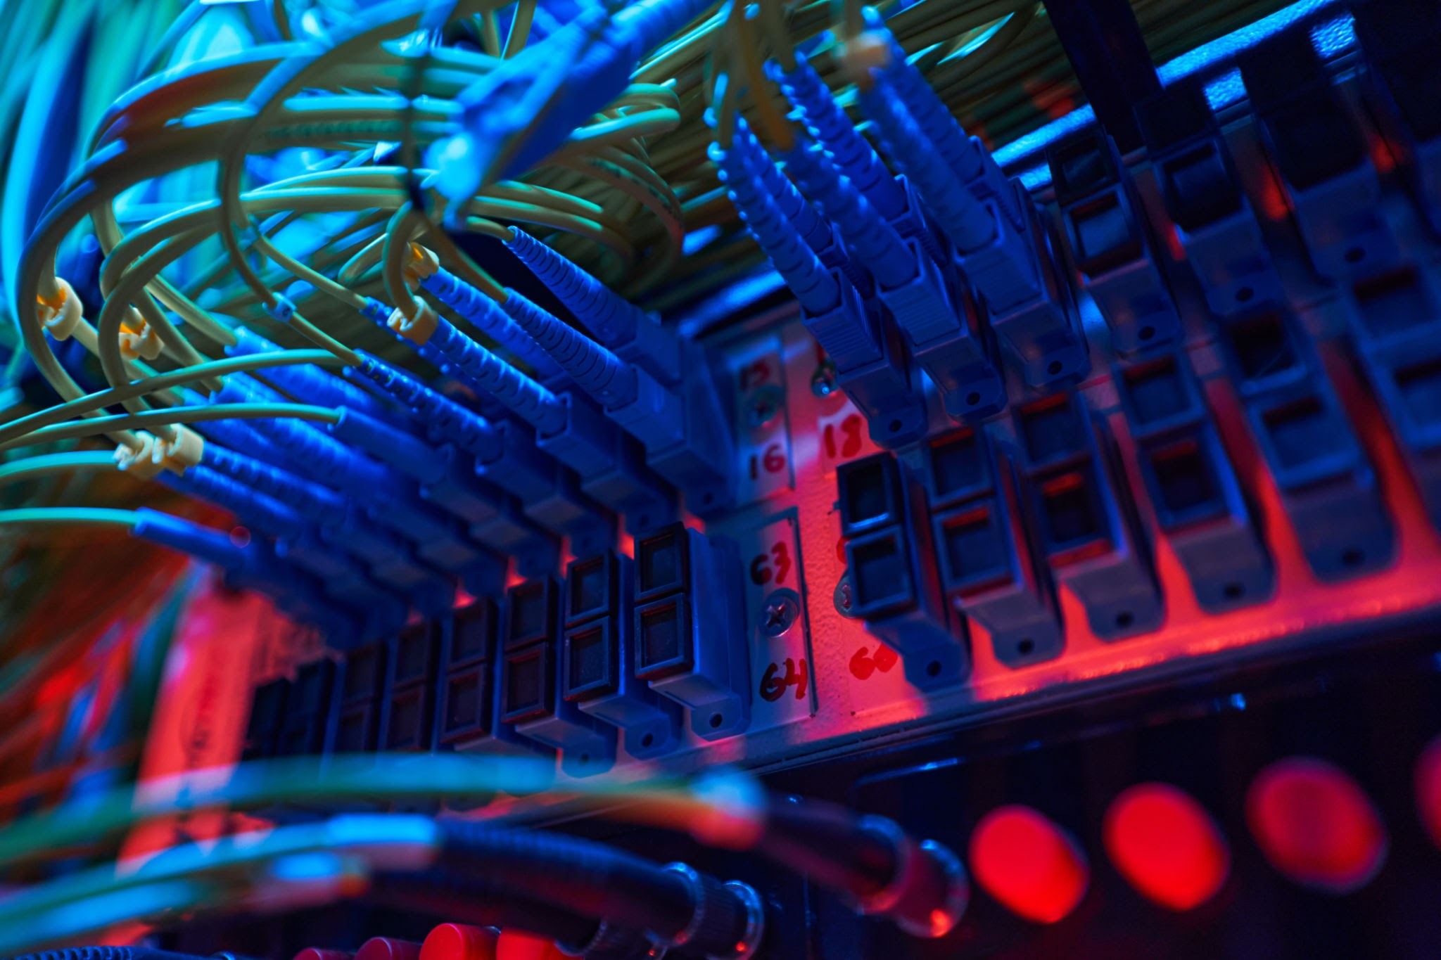
DHCP and Switch Hardware
DHCP assigns IP addresses automatically; switches connect internal devices.
Threats: Rogue DHCP servers, unauthorized devices.
Hardening: DHCP snooping, switch port security.

Slide 4

DNS
DNS translates domain names into IP addresses.
Threats: DNS spoofing, cache poisoning, DoS attacks.
Hardening: DNSSEC verification.

Slide 5

Routers
Routers manage traffic between internal systems and the internet.
Threats: Unauthorized access, route hijacking.
Hardening: Strong ACLs, encrypted management (SSH).

Slide 6
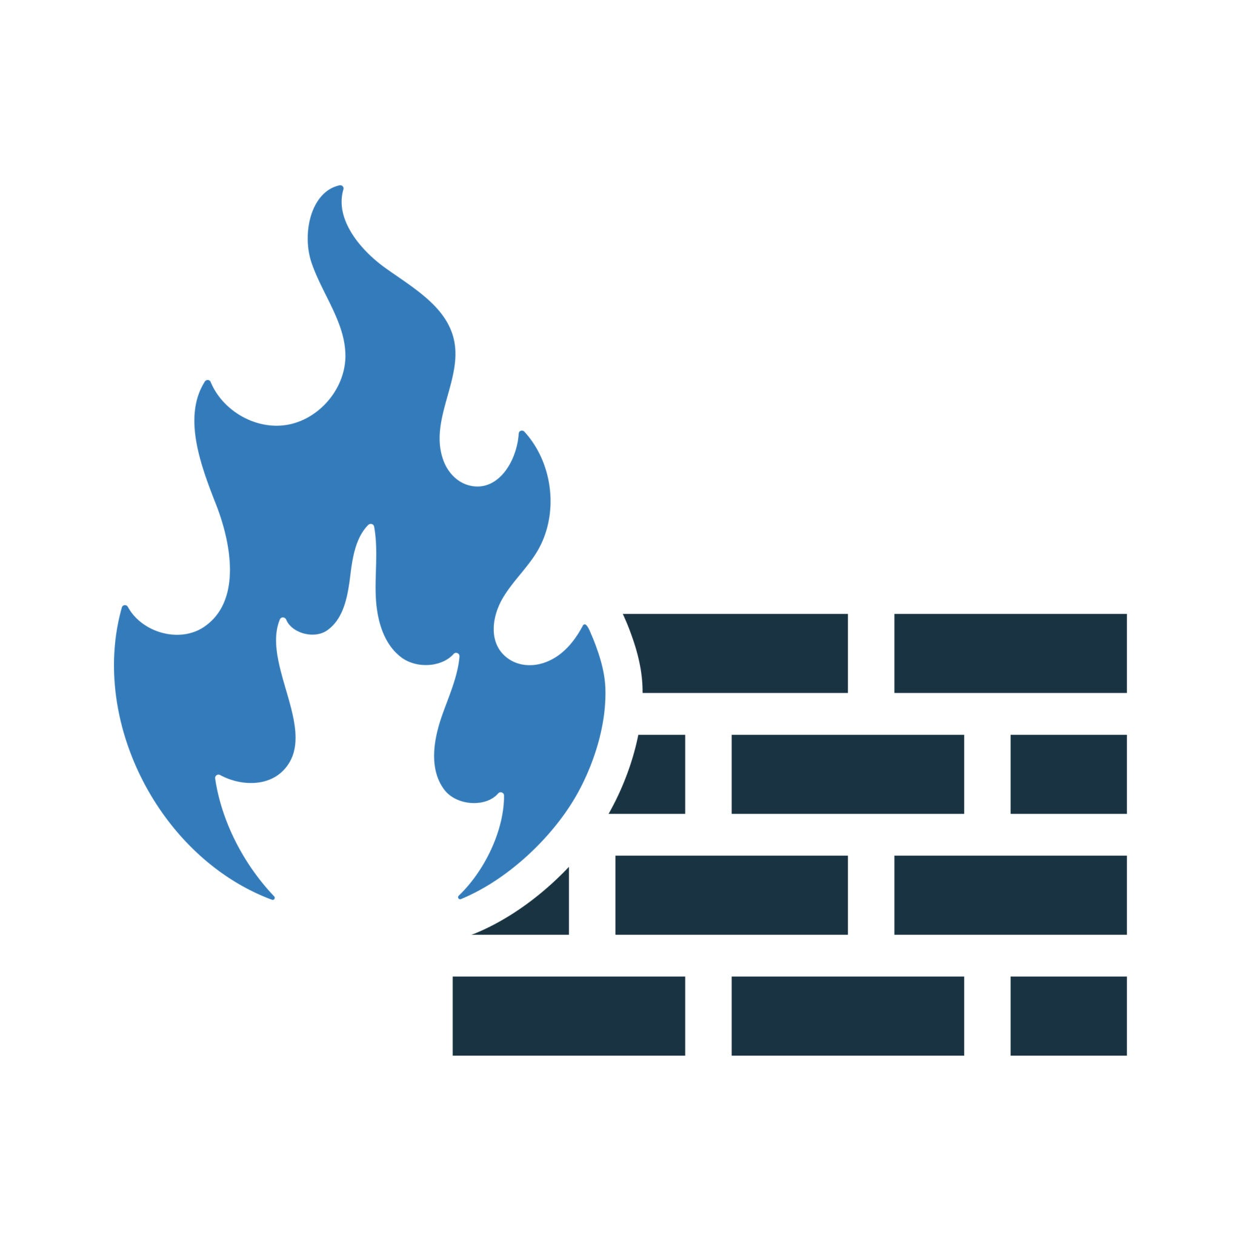
Firewalls and DMZ
Firewalls filter inbound and outbound traffic.
DMZ hosts public-facing systems like web servers.
Hardening: Layered firewalls, strict rules, traffic monitoring.

Slide 7
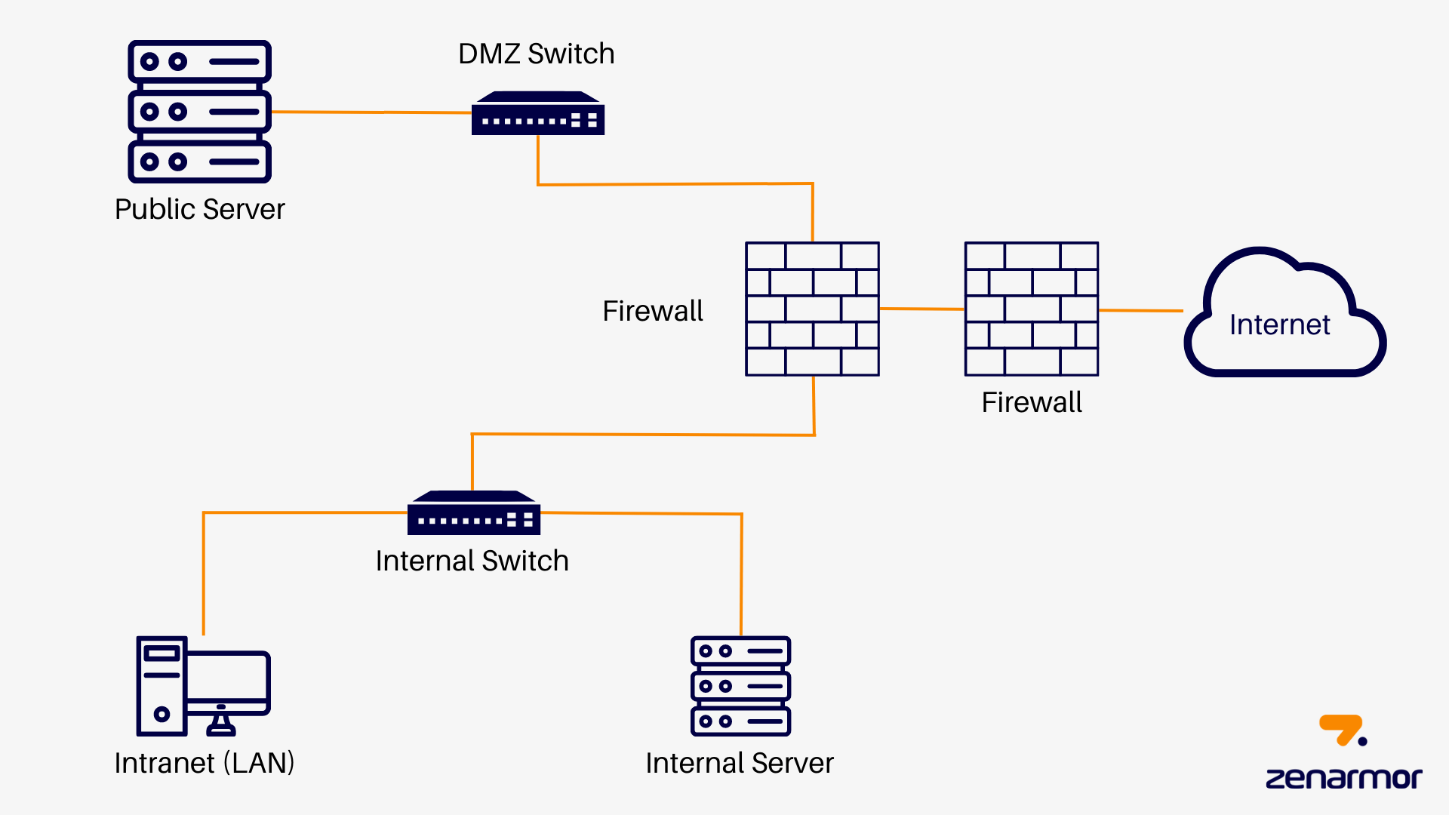
DMZ Logical Diagram
Internet → External Firewall → DMZ → Internal Firewall → Internal Network

Slide 8

Summary
Secure network design protects customer data and business operations.
Hardening each component reduces attack risk.
Security investments maintain reliability and trust.

